Slide 1
INTEGRATION OF MACHINE LEARNING KAIROS APPROACH TO ANAYSE HUMAN PERSONALITY
ISWARIYA RAMU(312416104044)
GAYATHIRI.K(312416104037)
PROJECT GUIDE:MR.C.GOWTHAM

Slide 2
ABSTRACT
To precisely examine facial expressions of criminal mental disorder inorder to find the changes in their emotions.
To find accurate solutions.
Depends on the varying expressions.

Slide 3
OBJECTIVE
To overcome the problem of unstable prediction of their varying facial expressions by using manual methods.
To precisely overcome this we propose the hybrid architecture.
This is done using various recoginition tests such as Pshycometric ,IQ and Pen test.

Slide 4
AN OVERVIEW OF THE PROJECT
Facial expressions can be considered not only as the most natural form of displaying human emotions but also as a key non-verbal communication technique. If efficient methods can be brought about to automatically recognize these facial expressions, striking improvements can be achieved in the area of human computer interaction. Research in facial emotion recognition has being carried out in hope of attaining these enhancements.

Slide 5
EXISTING SYSTEM
Existing systems are highly complex in terms of time and storage for recognizing user behavior. Existing system focus on only manual assessment which takes time and doesn’t provide promising results as the user emotions keeps varying based on personal, situational problems. Existing system doesn’t invoke biometric based emotion recognition of the users. Existing system doesn’t focus on user facial expression with cycometric test based automatic individual criminal behavior prediction

Slide 6
PROPOSED SYSTEM
Mental Illness has a profound impact on people’s functioning, health and quality of life. Detecting early warnings of depression or any other mental illness is challenging. The proposed system provides a hybrid architecture invoking facial based emotion sequence, PEN test, IQ test. By consistent monitoring of a human’s emotion and subjecting to PEN and IQ test, the human’s mental state is routed. Combination of above three techniques provides promising results for Criminal rehabilitation and self-control.

Slide 7
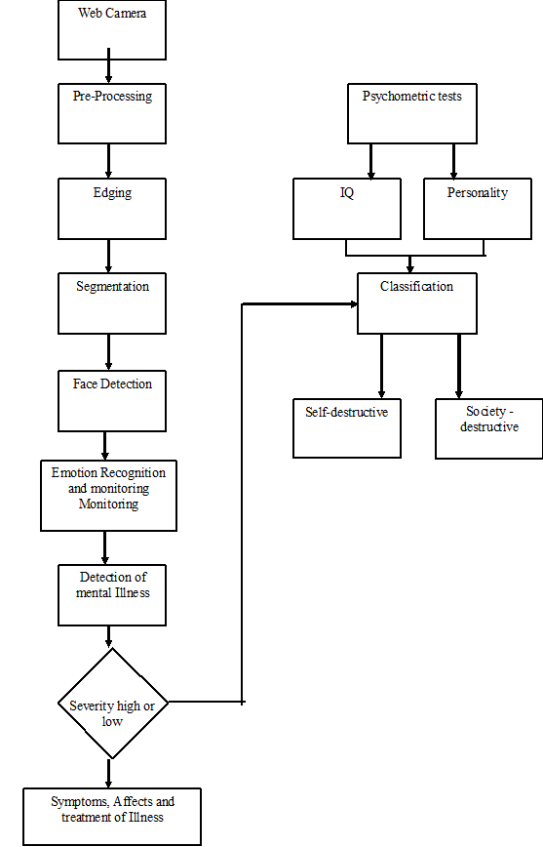
PROCESS FLOW

Slide 8
RECOGNITION TESTS
PSYCOMETRIC TEST:
The field is concerned with the objective measurement of skills and knowledge, abilities, attitudes, personality traits, and educational achievement. Some psychometric researchers focus on the construction and validation of assessment instruments such as questionnaires, tests, raters judgments, and personality tests.
IQ TEST:
IQ scores are used for educational placement, assessment of intellectual disability, and evaluating job applicants. Even when students improve their scores on standardized tests, they do not always improve their cognitive abilities, such as memory, attention and speed.

Slide 9
PEN TEST:
The process typically identifies the target systems and a particular goal, then reviews available information and undertakes various means to attain that goal. A penetration test target may be a white box (which provides background and system information) or black box (which provides only basic or no information except the company name). A gray box penetration test is a combination of the two (where limited knowledge of the target is shared with the auditor). A penetration test can help determine whether a system is vulnerable to attack if the defenses were sufficient, and which defenses (if any) the test defeated.

Slide 10
CONCLUSION
This paper provides a efficient way of recoginising facial expressions of criminal rehabilitants by using various recognition tests such as Psychometric ,pen,IQ tests.
This method will overcome the problems faced by the manual method which is a time consuming process and also memory inefficient.
Thus this will ensure us with the promising result by detecting the varying facial emotion of a criminal rehablitants.

Slide 11
REFERENCE
Alschuler, A.W. (2003). The Changing Purposes of Criminal Punishment: A Retrospective on the Last Century and Some Thoughts about the Next. University of Chicago Law Review 70(1): 1–22.
Barkley, R.A. (1997). ADHD and the Nature of Self-Control. New York: The Guilford Press.
Baroni, A., & Castellanos, F.X. (2015). Stimulants, cognitions and ADHD. Current Opinion in Behavioral Sciences 4: 109–114.
Baumeister, R.F., & Exline, J.J. (1999). Virtue, Personality and Social Relations: Self-Control as the Moral Muscle. Journal of Personality 67(6): 1165–1194.

Slide 12
THANKYOU

